Slide 1


Spontaneous Droplet Jump with Electro-bounce
Erin S. Schmidt Mark M. Weislogel
Notes:
\

Slide 2
With a μ-gravity drop tower we can (briefly) access regimes where surface tension predominates at macro-scales…
The Dryden Drop Tower
2.1 s of μ-gravity
Optimized for iteration
6800 drops over past 6 years
Up to ~100 drops per day
(Photo: Wollman, 2012)

Slide 3
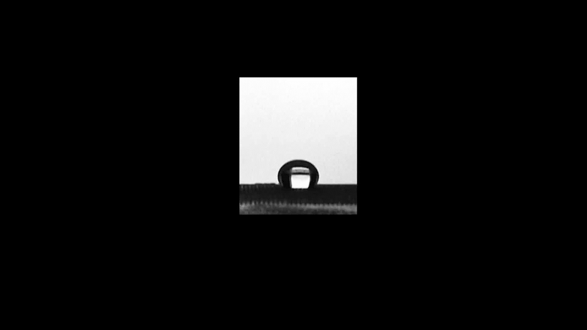
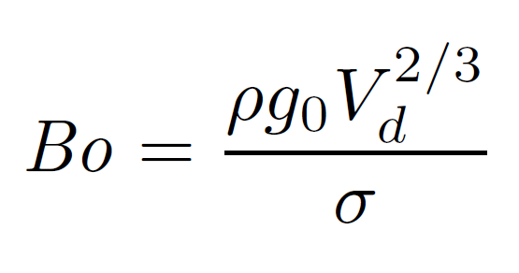
Droplets can spontaneously jump from superhydrophobic surfaces during step-reduction in Bo. Wollman, et al., (2016)
2 mm

Slide 4
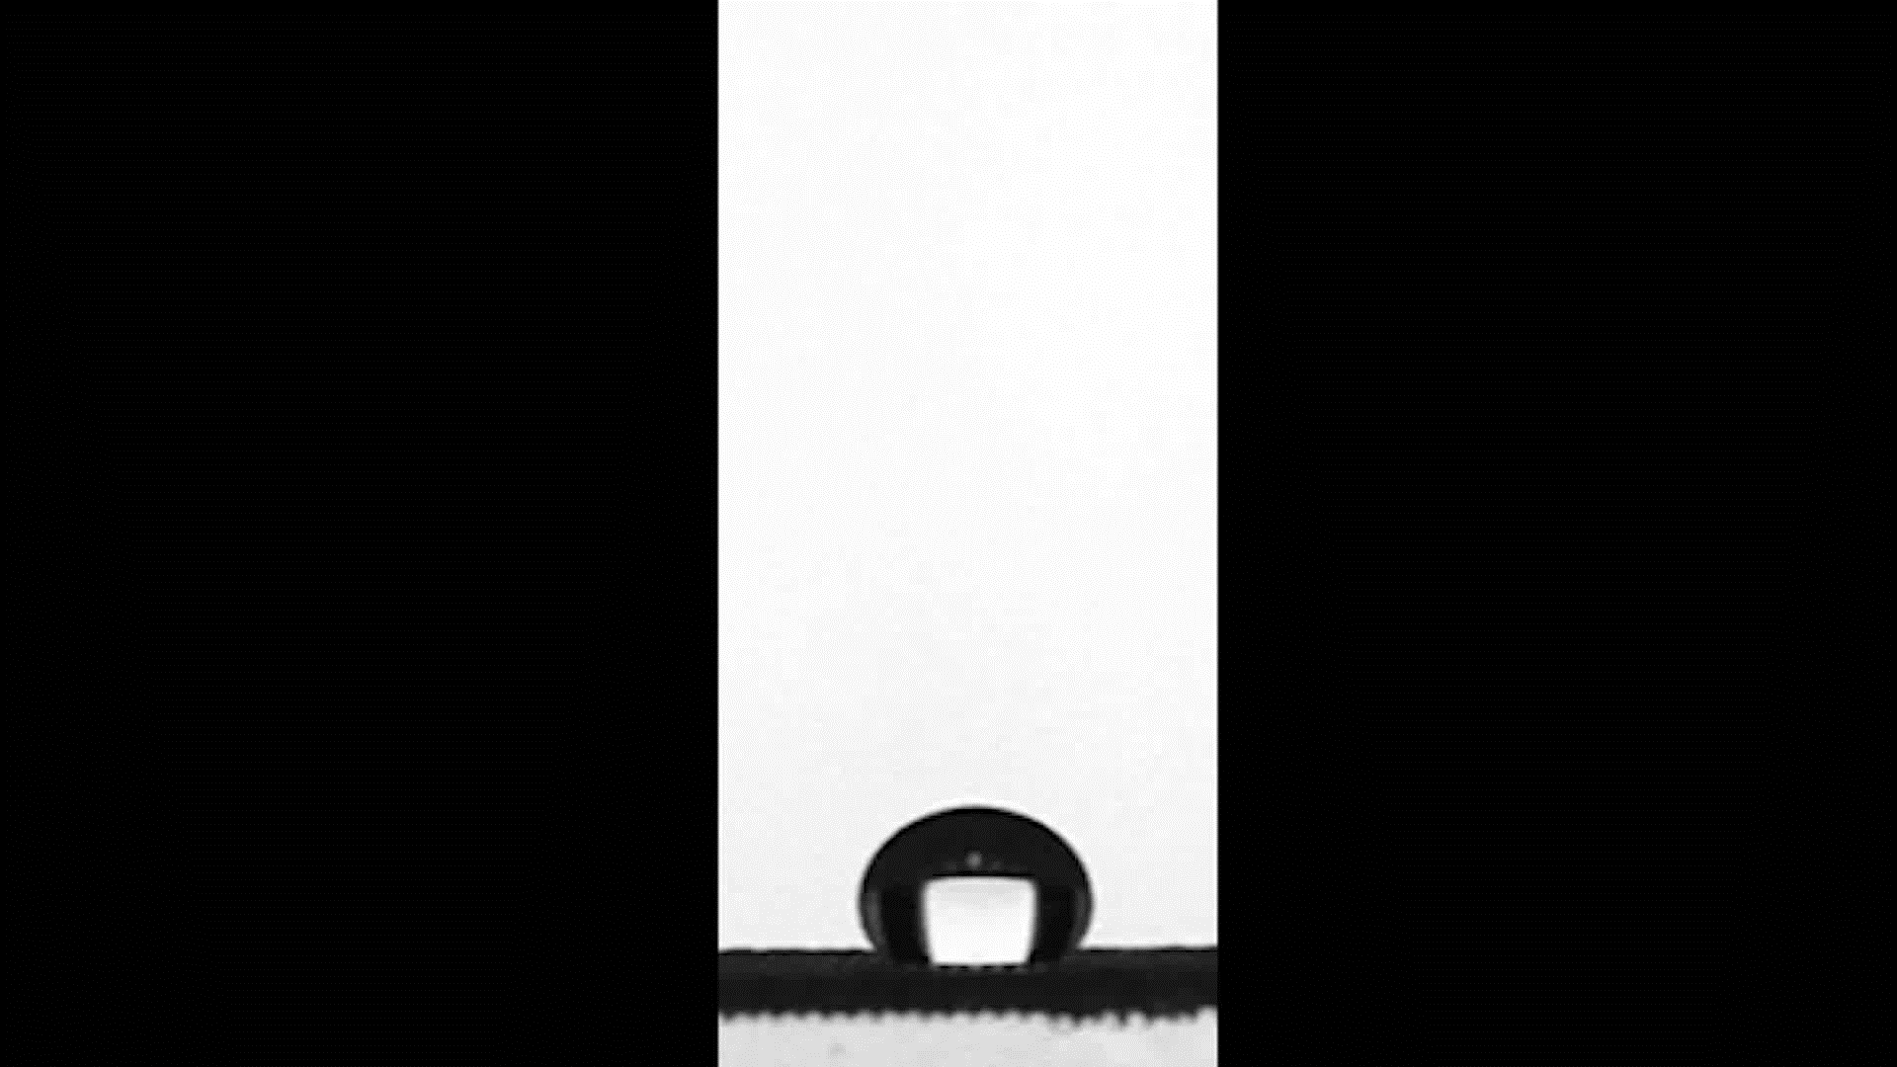

Slide 5
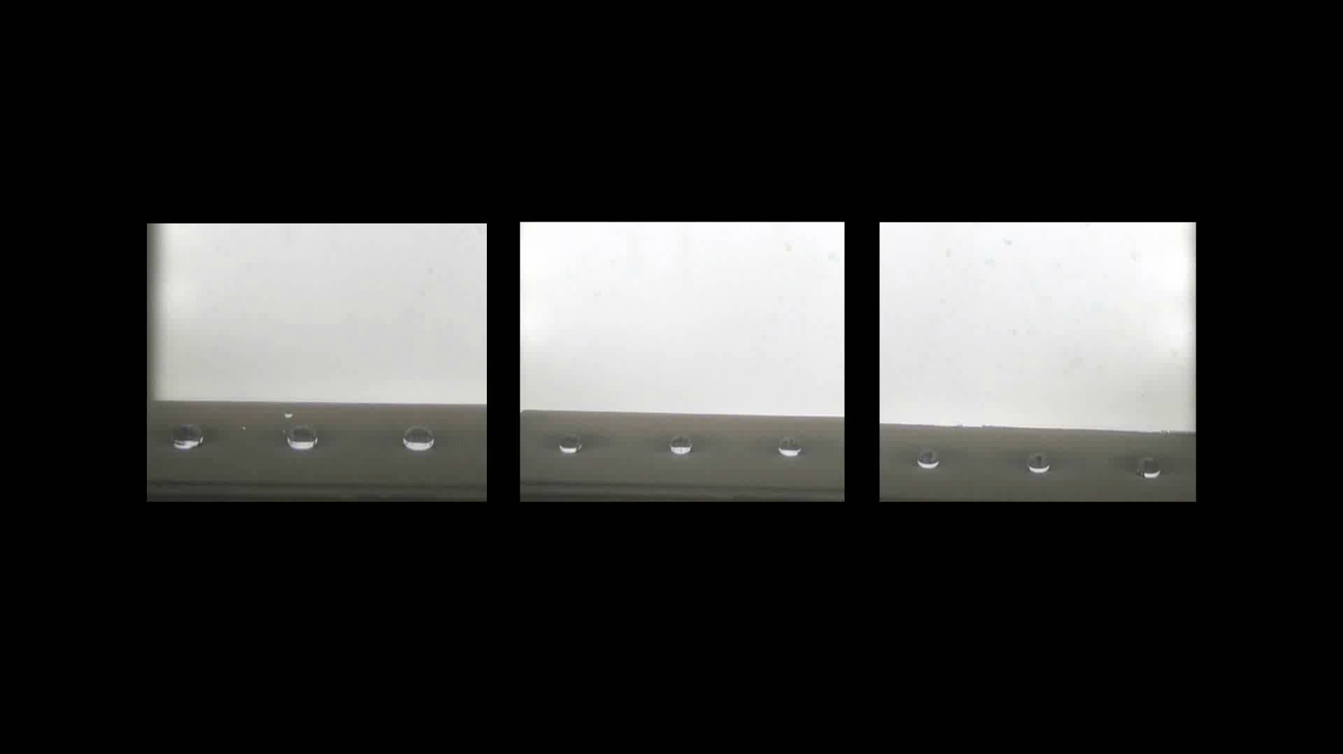
4 mm

Slide 7
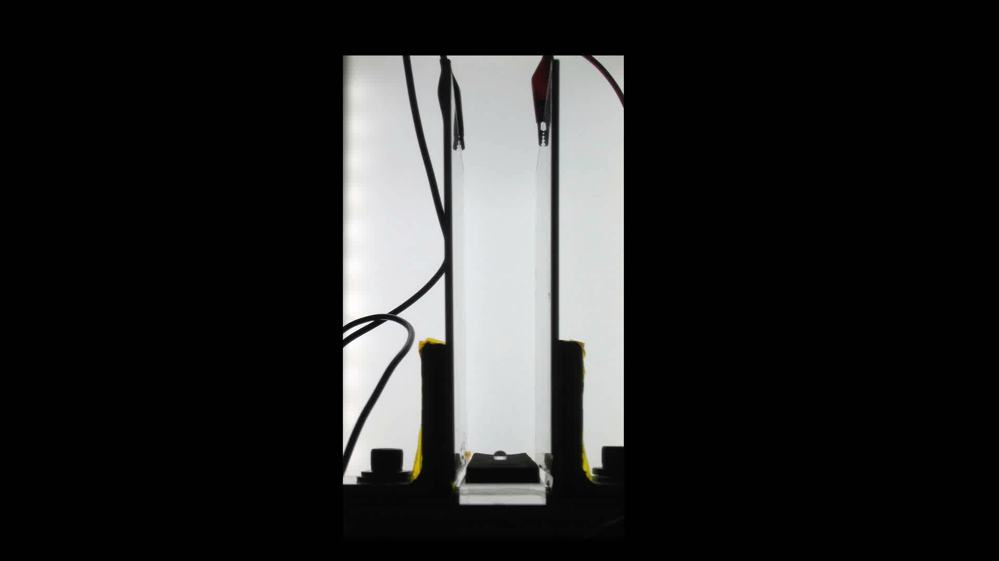
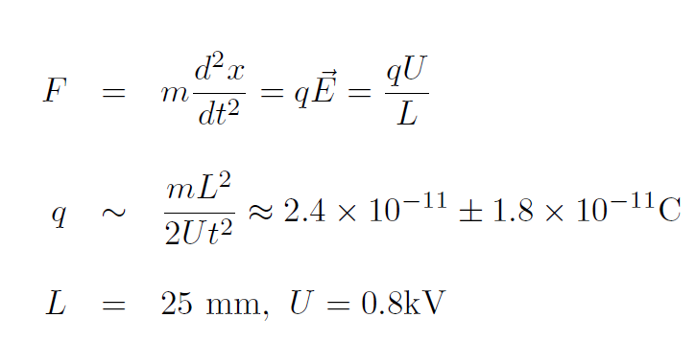
What is the source and magnitude of the charge?
PTFE coated surfaces can cause charge accumulation on water droplets. Choi, et al., (2013), Miljkovic, et al., (2013), Moreno-Villa, et al., (1998).
So, with some historical inspiration... Millikan, (1913).
-
+

Slide 8
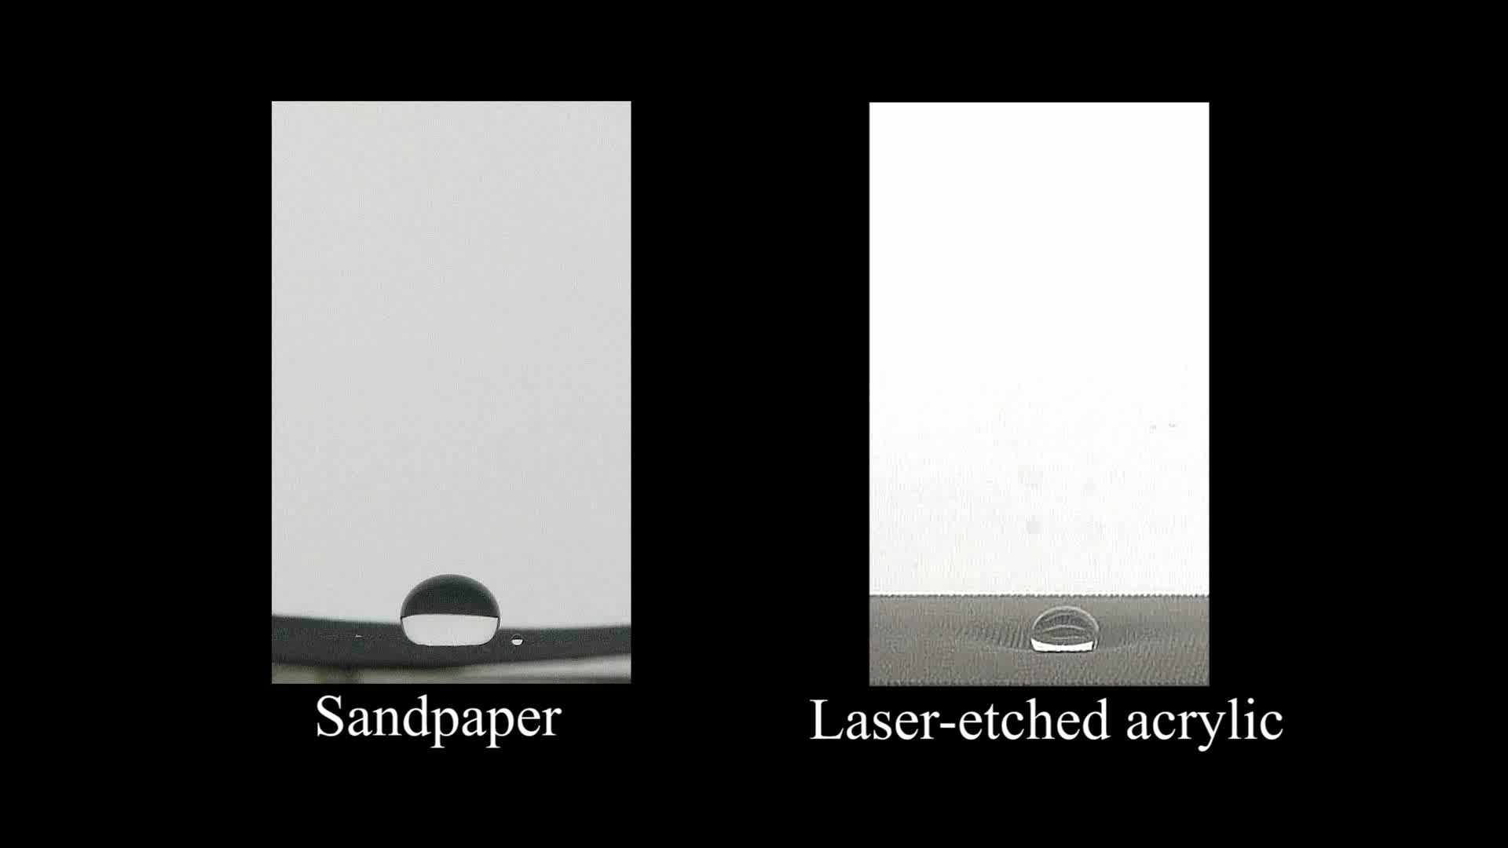
ρ_{c} ≈ 9.0×10⁻⁷ C/m²
V = 0.05 mL

Slide 9
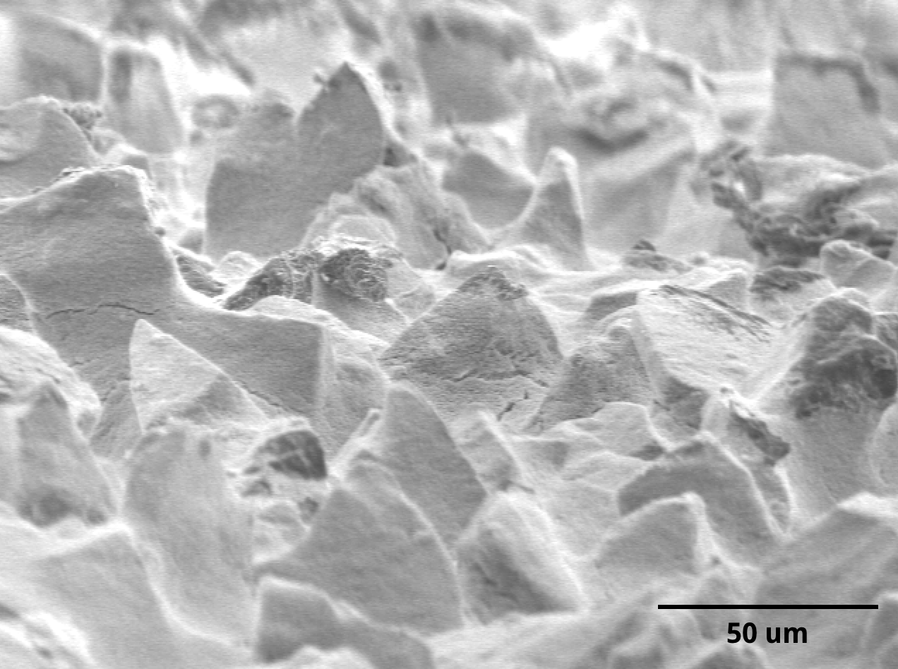
θ ≈ 158º±5º
θ_{roll-off} (2 mL) ≈ 2º
30 μm
θ ≈ 138º±5º
θ_{roll-off} (2 mL) ≈ 5º
500 μm
(Photo: Lindner, 2016)

Slide 10
Average ρ_{c} ~3.9x10⁻⁸ C/m²

Slide 12
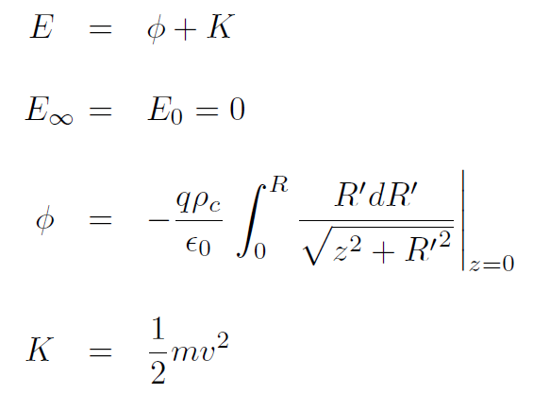
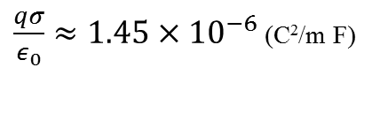
A gravitational analog
Ahh, the allure of simple ideas…

Slide 13
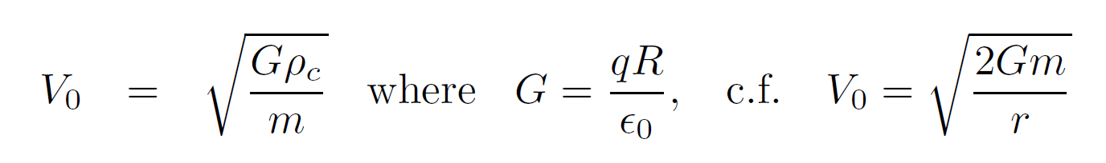
Escape velocity

Slide 15
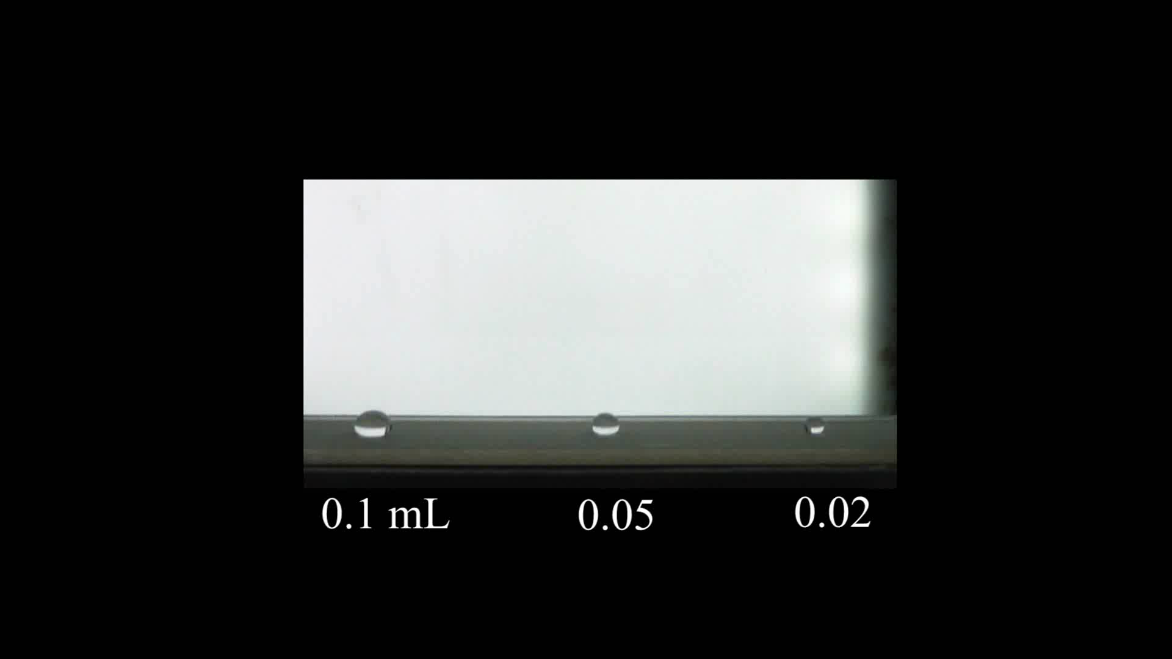

Slide 16
Summary
We bounced quite large (mm sized) droplets from super-hydrophobic surfaces in μ-gravity using an electric field
Jump occurs spontaneously during step-reduction in Bo
‘High-hysteresis’ super-hydrophobic surfaces with large ratios of roughness to droplet length-scale have lower jump velocities, and are more prone to bouncing
The occurrence of bouncing may be described by a simple analog to the escape velocity of astrodynamics

Slide 17
Acknowledgments
NASA This work was supported primarily by NASA Cooperative Agreement NNX12A047A.
DDT The amazing folk of the Dryden Drop Tower lab for their support and advice:
Dr. Andrew Wollman, Dr. Yongkang Chen, Taif Al Jubaree, Karl Cardin, Logan Torres, Isabel Rodriguez, and Dr. Mark Weislogel

Slide 18
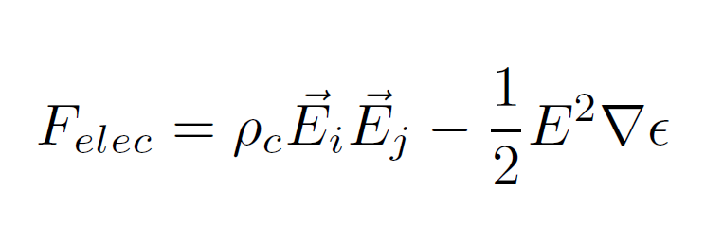
Why does the bouncing occur?
Well… It looks a lot like electrostatics

